Slide 1

Blending Genomics with Image Covariates
By: Foo En Teng Joel
Supervisors:
Prof. Alexandre H. Thiery
Dr. Jonathan Göke
(Senior Research Scientist, Genome Institute of Singapore)
ST4199 Honours Project In Statistics
Department of Statistics and Applied Probability
2017/2018
Notes:
Good morning, Professors and fellow honors students
The title of my FYP presentation is Blending Genomics with Image Covariates
Genomics comes from the word genome, a genome is the complete set of an organism’s DNA that contains all of its genes. And the Image covariates referred here are from digital tissue slide images

Slide 2
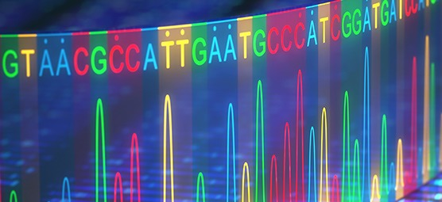
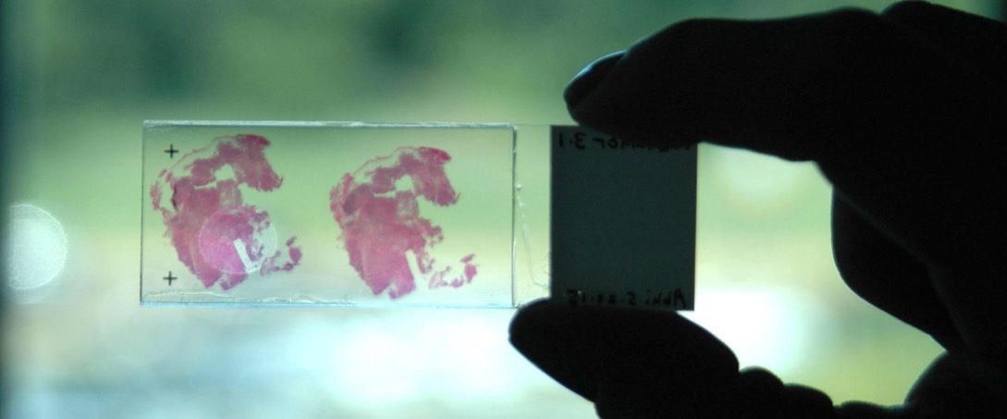
Background
Gene Discovery
Human Genome Project
2,000 genetic tests to assist in
disease diagnosis
Disease Discovery
Pathologists
Examined & interpreted to assess
disease condition
Image Source:
[1] http://amlaboratories.com/biopharma-solutions/molecular-genetics-genomics/
[2] https://www.rowan.edu/som/gsbs/academic/histopathology.php
Notes:
Allow me to begin by giving a background of genomics and whole tissue slide images
The human genome project is famous for discovering all the genes in a human and out of which came 2000 genetic tests which are used to assist disease diagnosis
However, more often than not, disease discovery is still done by a human. Pathologists examine live tissue sample of their patients before giving diagnosis

Slide 3
Background
Are there associations between them?
Blending
Image Source:
[1] http://amlaboratories.com/biopharma-solutions/molecular-genetics-genomics/
[2] https://www.rowan.edu/som/gsbs/academic/histopathology.php
Notes:
What if we could blend them together so that disease diagnosis can be data-driven?
But before any work can be done, we need to ask ourselves if there are associations between them.
If there are genes which indicate that a patient has a particular form of cancer, is there a link to a particular image feature?
How good are current technologies in making the link?

Slide 4
Outline
Introduction
Neural Network Concepts
Genomics & Digital Pathology
Classification
Encoded Image Covariates for Prediction
Conclusion

Slide 5
Scope & Objective
Scope: Utilization of neural networks to classify, encode and extract information for prediction
Objective: Implement & evaluate the use of neural networks to blend genomics and image covariates

Slide 6
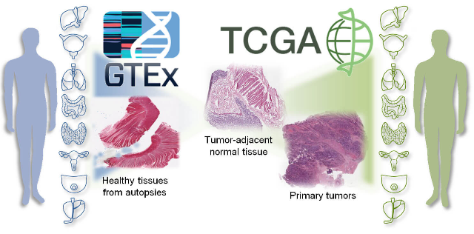
Motivations
Abundant Data
Massive Repositories
GTEx - 12,000 samples, 53 tissues,
714 donors
TCGA - 2.5 petabytes of data, 33 cancer types, 11,000 patients
Image Source:
[1] https://www.technologynetworks.com/cancer-research/news/normal-tissue-near-tumors-may-host-hidden-cancer-characteristics-293567
Notes:
There are two motivations to embark on this project
The abundance of data. The data used in this project comes from two repositories, Genotype-Tissue Expression (GTEx) consortium which has close to 12000 samples of 53 tissues and the cancer genome atlas, 2.5 petabytes, 10 to the power 15 [more than 6 years of non-stop full HD video recording] from 33 cancer types

Slide 7
Motivations
“Colorectal cancer numbers far too high, says experts”
ST, Nov 9, 2016
1.1 Million Death Toll by 2030
PubMed.gov - US National Library of medicine, National Institutes of Health
Image Source:
[1] http://www.straitstimes.com/singapore/health/new-therapies-offer-hope-to-cancer-patients-living-with-cancer
Notes:
The second motivation is by an article published on The Straits Times, five Singaporeans are diagnosed with colorectal cancer and two die of it daily. Despite it being easy to treat, you can see from the table that it ranks highly amongst the top deadly cancers in SG for both male and females.
Globally, colorectal cancer is the third most common cancer (Arnold et al., 2016), and by 2030, the expected death toll will reach 1.1 million.
Thus, out of the 33 cancer types from the massive TCGA repository my report will focus on colorectal cancer.

Slide 8
Outline
Introduction
Neural Network Concepts
Genomics & Digital Pathology
Classification
Encoded Image Covariates for Prediction
Conclusion
Notes:
Before we jump into the main bulk of my report, we ought to look at some theory on neural networks

Slide 9
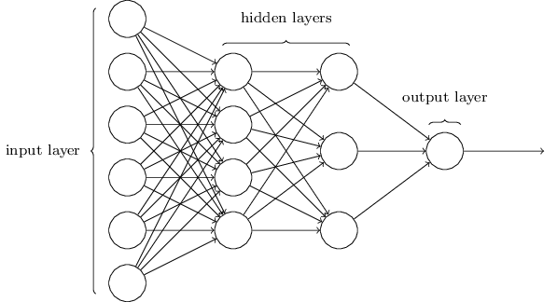
Neural Network Concepts
Black Box
Input
Covariates
Output
Image Source:
[1] Adapted from "Neural Networks and Deep Learning" by Nielsen, 2015, Determination Press.
Notes:
This is the usually what comes to mind when I think of neural network and I initially view it as black box where feed some inputs and it gives us an output and the magic that goes on behind is unknown
Although there is some truth to this statement, I wish to convince you that most of the mathematics to understand how it works is rather simple and is very useful to help me harness its power and understand its limitations

Slide 10
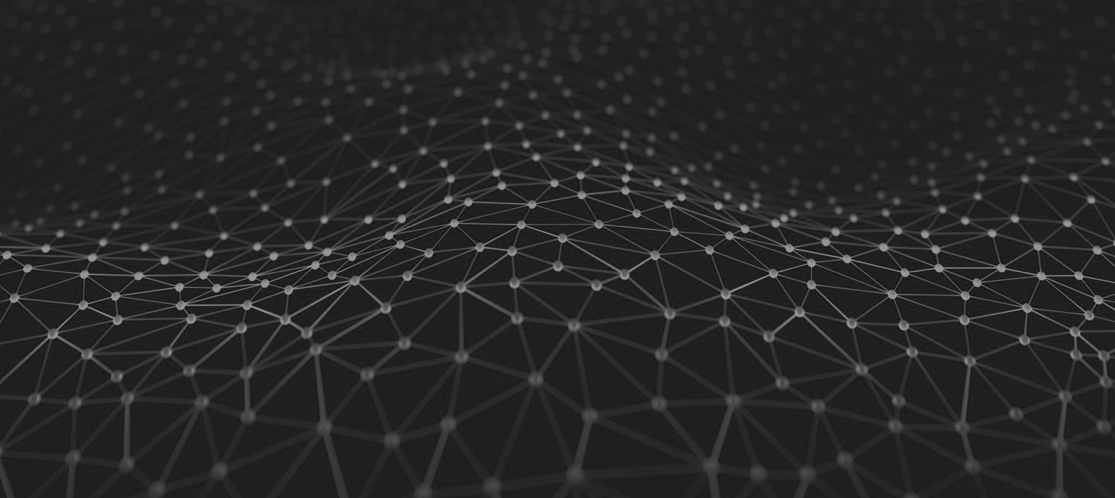
Neural Network Concepts
Activation Functions
Loss Functions
Backpropagation
Convolutional Neural Networks
Image Source:
[1] https://towardsdatascience.com/a-soft-introduction-to-neural-networks-6986b5e3a127
Notes:
This are the few concepts which I will be touching on

Slide 11
Activation Functions
Image Source:
[1] https://d4datascience.wordpress.com/2016/09/29/fbf/
Notes:
Neural networks are made of neurons and each neuron consist of a linear combination and non-linearity (a.k.a activation functions)
Activation functions help to stabilize the network during training by preventing a large change in weights. These are the three common activation functions used in my report
From the graphs, one can see that they are increasing, mostly continuous and differentiable, and they are applied on the dot product between weights and an input plus bias

Slide 12
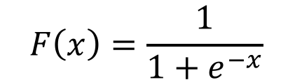
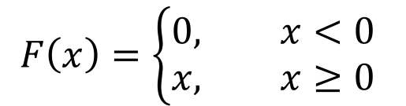
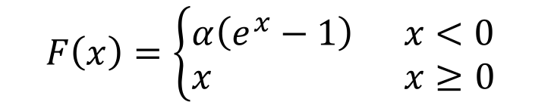
Activation Functions
Sigmoid
ReLU
ELU
$$F\left(x\right)=\frac{1}{1+e^{−x}}$$
$$F\left(x\right)=\left\{\begin{aligned}0, x<0 \\ &x, x≥0\end{aligned}\right.$$
$$F\left(x\right)=\left\{\begin{aligned}α\left(e^{x}−1\right) x<0 \\ &x x≥0\end{aligned}\right.$$
Monotonically Increasing,
Continuous, Differentiable
$$F\left(w^{⊺}x+b\right)$$
Notes:
Neural networks are made of neurons and each neuron consist of a linear combination and non-linearity (a.k.a activation functions)
Activation functions help to stabilize the network during training by preventing a large change in weights. These are the three common activation functions used in my report
From the graphs, one can see that they are increasing, mostly continuous and differentiable, and they are applied on the dot product between weights and an input plus bias

Slide 13
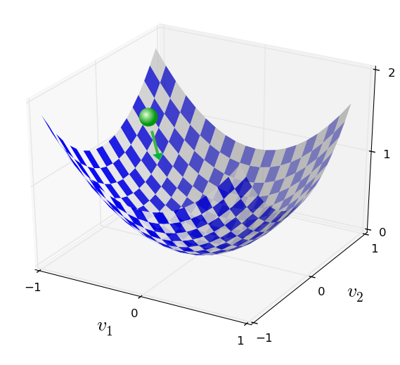
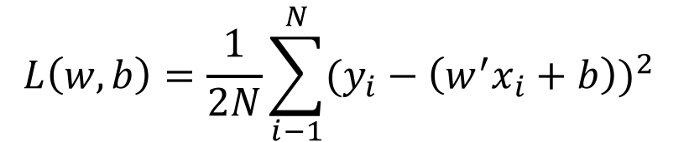
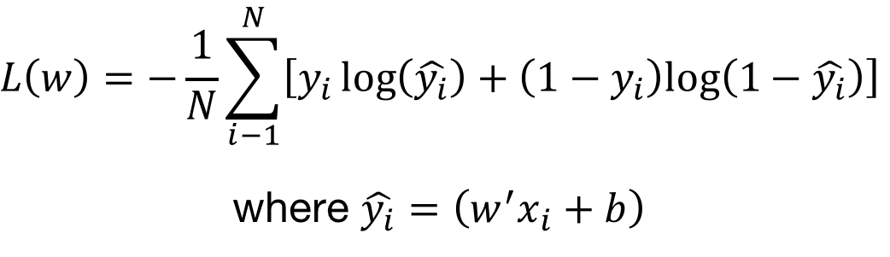
Loss Functions
Mean-Squared Error
$$L\left(w,b\right)=\frac{1}{2N}\sum_{i−1}^{N}{{(y_{i}−\left(w^{′}x_{i}+b\right))}^{2}}$$
Cross-Entropy
$$L\left(w\right)=−\frac{1}{N}\sum_{i−1}^{N}{\left[y_{i}\log\left(\hat{y_{i}}\right)+\left(1−y_{i}\right)log\left(1−\hat{y_{i}}\right)\right]}$$
where $\hat{y_{i}}=\left(w^{′}x_{i}+b\right)$
Minimized with
Gradient Descent
Image Source:
[1] Gradient descent illustration on Function C : R2 → R. Adapted from "Neural Networks and Deep Learning" by Nielsen, 2015, Determination Press.
Notes:
During training of a NN, we aim to find an optimal set of weights and biases to minimize the loss function during training (i.e. the prediction is closer to the truth, or there is less difference between the prediction and the truth)

Slide 14
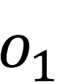
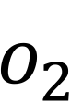
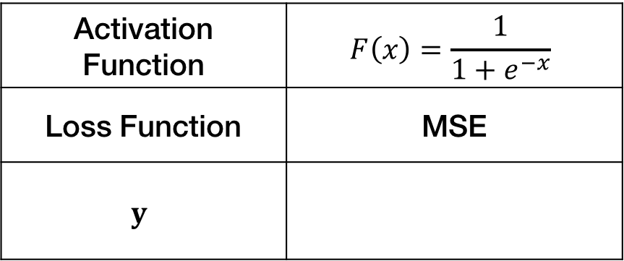
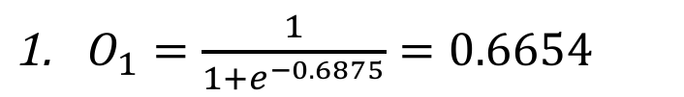
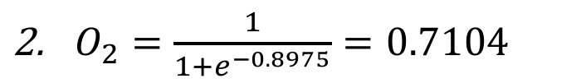
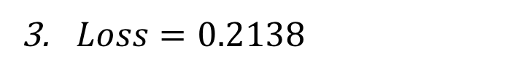
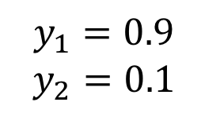
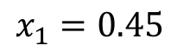
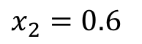
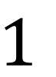
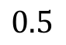
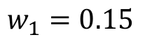
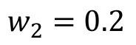
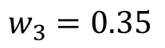
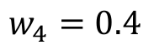
Backpropagation – Forward Pass
Activation Function | $$F\left(x\right)=\frac{1}{1+e^{−x}}$$
Loss Function | MSE
$$y$$
$$1$$
$$0.5$$
$$y_{1}=0.9$$
$$y_{2}=0.1$$
$$w_{1}=0.15$$
$$o_{1}$$
$$x_{1}=0.45$$
$$w_{2}=0.2$$
$O_{1}=\frac{1}{1+e^{−0.6875}}=0.6654$
$O_{2}=\frac{1}{1+e^{−0.8975}}=0.7104$
$$w_{3}=0.35$$
$$o_{2}$$
$$x_{2}=0.6$$
$$w_{4}=0.4$$
$Loss=0.2138$
Notes:
Backpropagation is an important algorithm that enables learning to take place In neural networks, in essence it helps to update weights
I have prepared a simple example to illustrate the process. What I will present will be a summary of it, if required, I can go through in greater detail during the Q&A
There are 2 main processes the forward pass and backward pass.
For the forward pass, we perform a linear combination of the weights and inputs and pass the result to the activation function to calculate the outputs, O1 and O2 subsequently we compute the loss

Slide 15
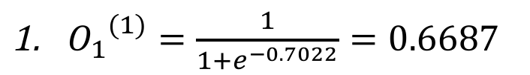
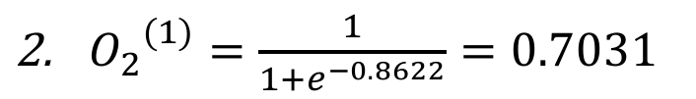
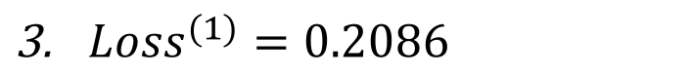
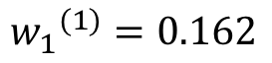
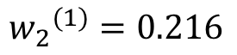
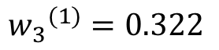
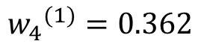
Backpropagation – Backward Pass
Activation Function | $$F\left(x\right)=\frac{1}{1+e^{−x}}$$
Loss Function | MSE
$$y$$
$$1$$
$$0.5$$
$$y_{1}=0.9$$
$$y_{2}=0.1$$
$${w_{1}}^{(1)}=0.162$$
$$o_{1}$$
$$x_{1}=0.45$$
$${w_{2}}^{(1)}=0.216$$
${O_{1}}^{(1)}=\frac{1}{1+e^{−0.7022}}=0.6687$
${O_{2}}^{(1)}=\frac{1}{1+e^{−0.8622}}=0.7031$
$${w_{3}}^{(1)}=0.322$$
$$o_{2}$$
$$x_{2}=0.6$$
${Loss}^{(1)}=0.2086$
$${w_{4}}^{(1)}=0.362$$
After Weights Update
Training Loss Decreased!

Slide 16
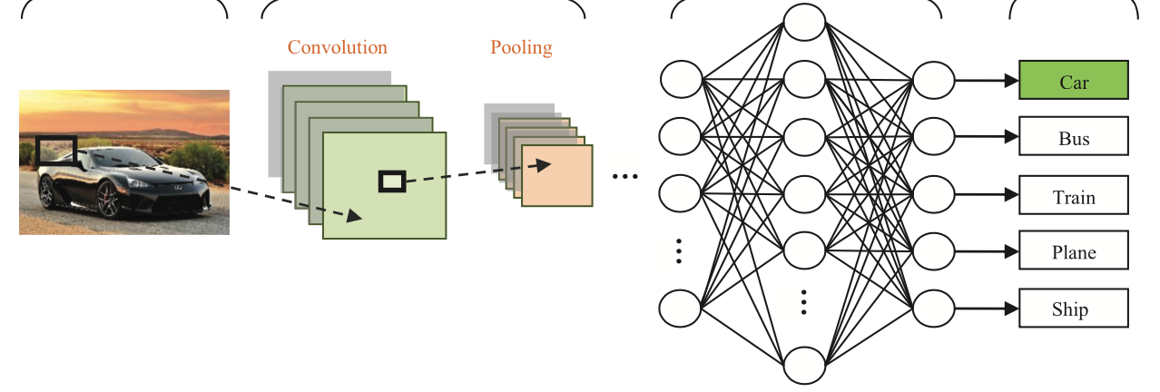
Convolutional Neural Networks
Convolution
Pooling
Image Source:
[1] CNN image pipeline. Adapted from "Deep Convolutional Neural Networks for Image Classification: A Comprehensive Review" by Rawat and Wang, 2017, Neural Computation.
Notes:
Image pixels tend to be spatially correlated i.e. pixels which are close together tend to be more similar than those further apart. Convolutional layers within the network convolve around the input image and produce feature maps which preserve the spatial structure.

Slide 17
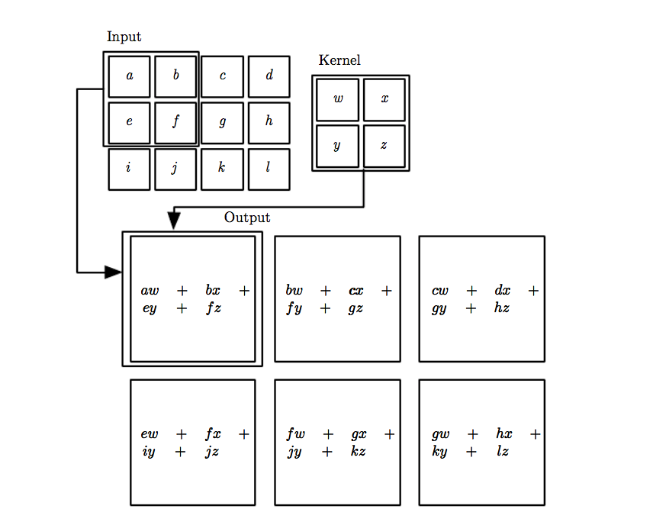
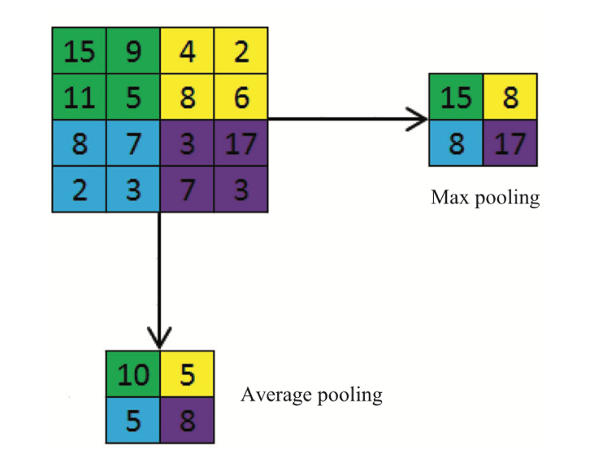
Convolutional Neural Networks
Max
Pooling
Average Pooling
Convolution
Pooling
Kernel: Feature Identifiers
Output: Feature Map
Translational Invariance
Down-sampling
Reduce Num. Weights
Better Generalization
Image Source:
[1] Convolution layer. Adapted from "Deep Learning" by Goodfellow et al., 2016, MIT Press.
[2] Pooling layer illustration. Adapted from "Deep Convolutional Neural Networks for Image Classification: A Comprehensive Review" by Rawat and Wang, 2017, Neural Computation.
Notes:
Convolution
The weights and biases of the kernel are shared between all nodes in the feature map. Thus, all the nodes detect the presence of the same feature. This results in the translation invariance
This is useful in practice as locations of distinct features of an images are translated (flipped, stretched, rotated) across the training and testing images. With translation invariance, the presence of these features are still identified by the feature map regardless
of their exact location.

Slide 18
Outline
Introduction
Neural Network Concepts
Genomics & Digital Pathology
Classification
Encoded Image Covariates for Prediction
Conclusion

Slide 19
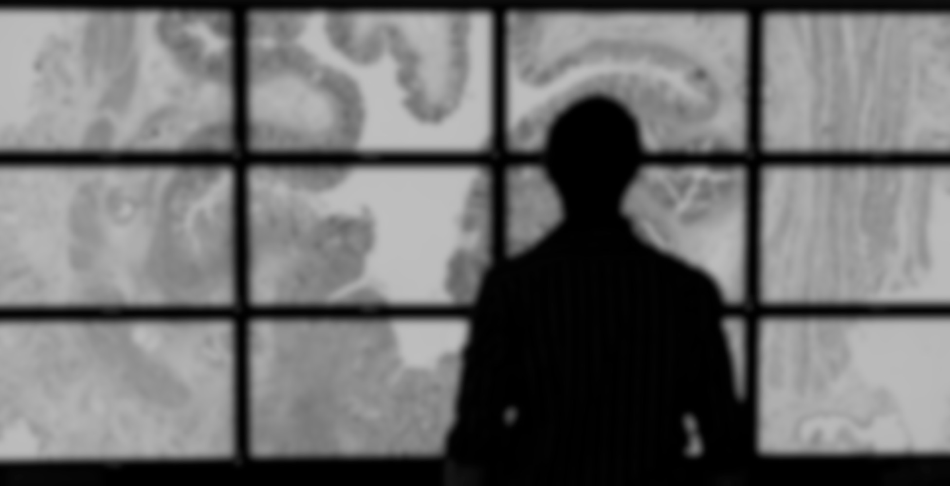
Genomics & Digital Pathology
Protein Synthesis
RNA-seq Data
Tumor Purity
Color Normalization
Tiles Generation
Image Encoding
Image Source:
[1] https://www.rcpath.org/profession/digital-pathology.html

Slide 20
Protein Synthesis
DNA
Transcription
mRNA
Transcript (RNA)
Translation
Polypeptide
(Building blocks of proteins)
Image Source:
[1] https://www.khanacademy.org/science/biology/gene-expression-central-dogma/transcription-of-dna-into-rna/a/overview-of-transcription
Notes:
Transcription
Deoxyribonucleic Acid (DNA) contains code that controls cellular function (i.e. what proteins are produced). DNA is transcribed to produce messenger Ribonucleic Acid (mRNA).
Translation
mRNA binds with the ribosome and produces an amino acid. The ribosome moves down the mRNA and more amino acids are added to form a chain.

Slide 21
RNA-seq Data
1
2
Samples of Interest
Isolate RNAs
Prepare for Sequencing
Healthy
Tumorous
3
4
Samples
Hundred of Millions of Reads
Genes
Data
Mapped to Reference Genome
High-throughput Sequencer
Image Source:
[1] http://slideplayer.com/slide/10693114

Slide 22
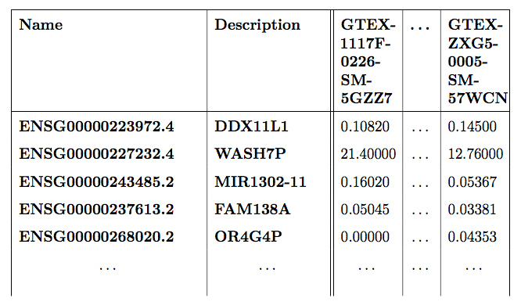
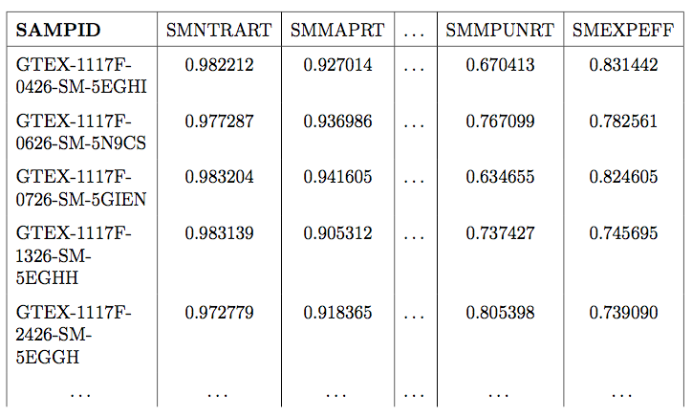
RNA-seq Data
1
Gene Transcripts per Million (TPM)
Annotations
2
Samples of Interest
Isolate RNAs
Prepare for Sequencing
Healthy
Tumorous
3
4
Samples
Hundred of Millions of Reads
Converted from read counts for easier comparison between different samples
Qualitative & quantitative metrics of reading/mapping process
Genes
Data
Mapped to Reference Genome
High-throughput Sequencer
Image Source:
[1] http://slideplayer.com/slide/10693114

Slide 23
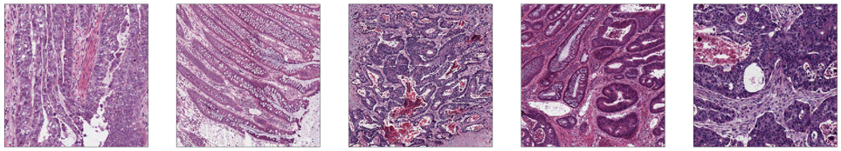
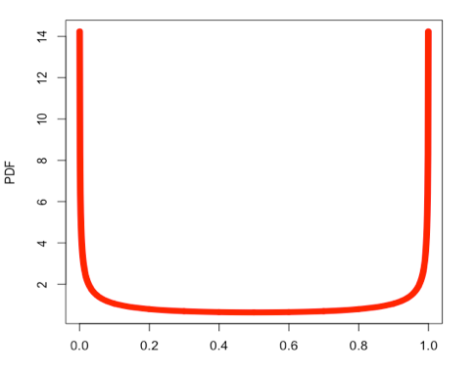
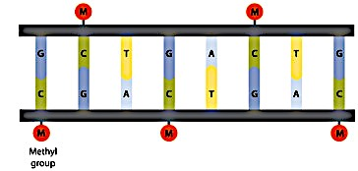
Tumor Purity
0.63
0.48
0.91
0.70
0.76
Purity Score
DNA
Methylation Data
Bimodal Beta
Distribution
Tumor samples have higher percentage of CpG sites with DNA methylation
Image Source:
[1] DNA methylation illustration. Adapted from "Introduction to DNA methy- lation" by Bagga, 2012, BioFiles, Epigenetics.
Wang, F., Zhang, N., Wang, J., Wu, H., & Zheng, X. (2016). Tumor purity and differential methylation in cancer epigenomics. Briefings in functional genomics, 15(6), 408–419.
Notes:
Tumor purity is a measure of the proportion of cancer cells in the tissue sample
In a tumor sample, percentage of CpG sites with intermediate methylation is significantly higher, which is a result of the cell mixture.
Taking advantage of this observation, InfiniumPurify first selects ‘informative’ probes (those showing DM between tumor and normal, and highly variable in tumor samples), and then estimates the purities from the modes of probability density of the methylation levels (beta values) from these probes

Slide 24
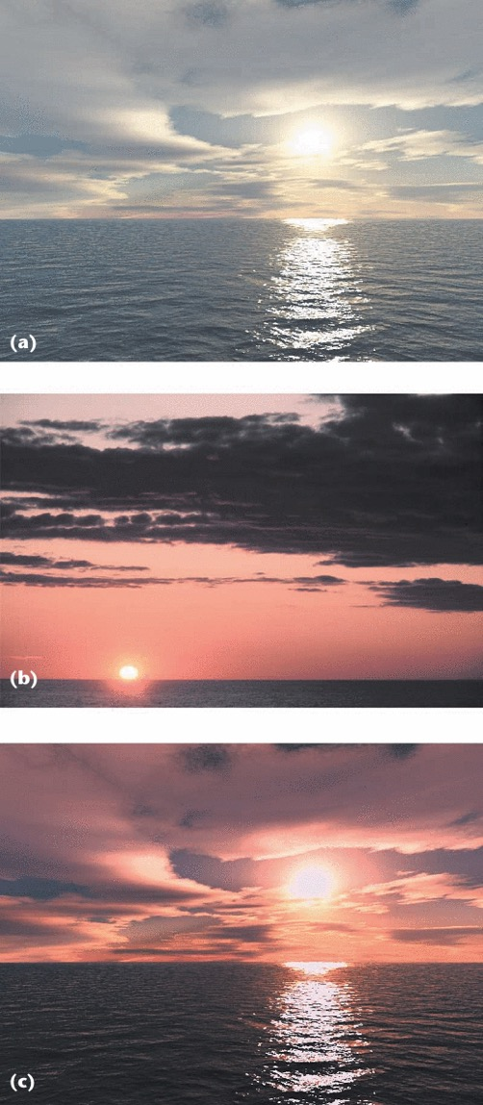
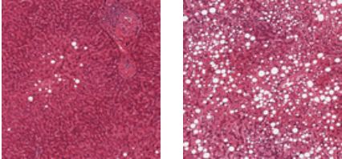
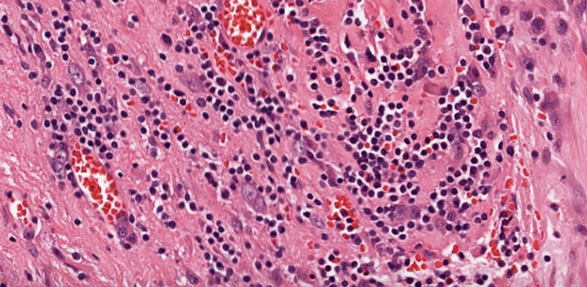
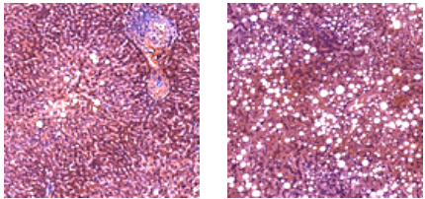
Color Normalization
Before Normalization
Gold-standard calibration image
After Reinhard Normalization
Image Source:
[1] http://ieeexplore.ieee.org.libproxy1.nus.edu.sg/mediastore/IEEE/content/media/38/20481/946629/946629-fig-1-hires.gif
[2] https://data.kitware.com/api/v1/file/57718cc28d777f1ecd8a883c/download
Reinhard, E., Adhikhmin, M., Gooch, B., & Shirley, P. (2001). Color transfer between images. IEEE Computer graphics and applications, 21(5), 34–41.

Slide 25
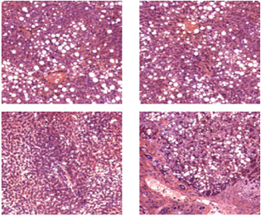
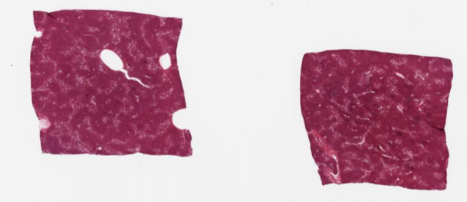

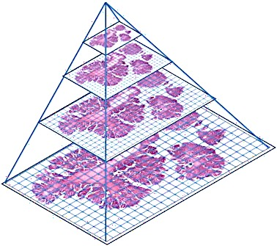
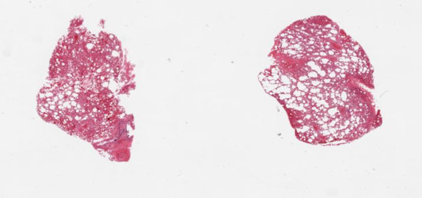






Tiles Generation
Liver Tissue
Lung Tissue
Colon Cancer Tissue
Image Source:
[1] https://www.ebi.ac.uk/gxa/about.html
[2] http://ciriellolab.org/research.html
Image Source:
[1] Adapted from "Digital pathology and image analysis in tissue biomarker research" by Hamilton et al., 2014, Methods(1).

Slide 26


Image Encoding
Encoder
Decoder
Original
Input
(128 X 128)
Reshaped Encoded
Representation
(32 X 32)
Reconstructed Input
(128 X 128)
Are important information loss in the process?

Slide 27
Outline
Introduction
Neural Network Concepts
Genomics & Digital Pathology
Classification
Encoded Image Covariates for Prediction
Conclusion
Notes:
This chapter

Slide 28












Liver vs. Lung
$$\text{Convolutional}$$
$$\text{Max} \text{Pooling}$$
$$\left\{\begin{aligned}ℙ(\text{Liver}) \\ ℙ(\text{L}\text{ung})\end{aligned}\right.$$
$$\text{Fully} \text{Connected}$$
$$27×27×32$$
$$57×57×16$$
$$128×128×3$$
$$121×121×8$$
Liver
Lung
95.5% Accuracy
1,711 out of 1791 Test Tiles

Slide 29


Tumor vs. Non-Tumor
Tumor
Non-Tumor
NN Architecture | #. Trainable Parameters | Accuracy | AUC
Simple CNN | 178,842 | 64.5% | 0.68
VGG16 | 526,338 | 61.7% | 0.66
ResNet50 | 36,127,746 | 72.4% | 0.87
Notes:
Next we utilize NN to classify tumor and non-tumor tissue samples. Can anyone make a guess which is which? It is quite difficult to differentiate
We use the simpleNN that we used previously for the lung vs. liver tissue data as our baseline and we proceed to test the hypothesis if more sophisticated networks would lead to a better accuracy with the VGG16 and ResNet50 networks, which I will touch more in a bit
From this result, you can notice that increasing the number of trainable parameters, does not always lead to an improvement in accuracy

Slide 30



Tumor vs. Non-Tumor
Tumor
Non-Tumor
VGG16
Pre-Training
Transfer Learning
Residual Learning
NN Architecture | #. Trainable Parameters | Accuracy | AUC
Simple CNN | 178,842 | 64.5% | 0.68
VGG16 | 526,338 | 61.7% | 0.66
ResNet50 | 36,127,746 | 72.4% | 0.87
Residual Block
Image Source:
[1] Root-to-leaf branches of ImageNet. Adapted from "ImageNet: A large-scale hierarchical image database" by Deng et al., 2009
[2] VGG16 Architecture. Adapted from "Building powerful image classification models using very little data" by Chollet, 2016b.
[3] Residual block. Adapted from "Deep Residual Learning for Image Recogni- tion" by He et al., 2015a.
Notes:
This practice might seem unusual when applied to tissue samples however Xu et al. (2017) argues that:
"Responses of CNN hidden layers provide different levels of image abstraction and can be used to extract complex features like human faces and natural scenes. It makes extracting sufficient information from medical images possible." (Xu et al., 2017, p. 281)
Xu et al.’s approach resulted in good performance on the classification and segmentation of brain tumor and colon cancer images. (Large
scale tissue histopathology image classification, segmentation, and visualization via
deep convolutional activation features)
Residual Block
The authors of ResNet hypothesized that direct mappings are hard to learn
Instead of trying to learn an underlying mapping from x to H(x)
Learn the difference between the two, or the “residual.” Then, to calculate H(x), we can just add the residual to the input.
Say the residual is F(x)=H(x)-x. Now, instead of trying to learn H(x) directly, our nets are trying to learn F(x)+x.
Block consists of a series of layers and a shortcut connection adding the input to its output, ADD operation is done element wise
Easier to learn to push F(x) to 0 and leave output as x than to learn an identity transformation from scratch, ResNet gives layers a reference point x to start learning from
Vanishing Gradients
Gradient signals from the error function decreased exponentially as they backpropagated to earlier layers.
- By the time the error signals traveled all the way back to the early layers, they were so small that the net couldn’t learn

Slide 31








Tile Level vs. Slide Level
Generate Tiles
Train Model & Predict (Tile)
Aggregate (Mean/Median)
Predict (Slide)
1
$$T$$
$$T$$
$$NT$$
$$p_{1}$$
$$p_{2}$$
$$…$$
$$p_{n}$$
2
$$\hat{p_{slide}}$$
3
4
AUC for Mean: 0.9318
AUC for Median: 0.9167
Image Source:
[1] Adapted from "Digital pathology and image analysis in tissue biomarker research" by Hamilton et al., 2014, Methods(1).
Notes:
Do the aggregated probability of tumor classification at the tile level correspond with the slide’s classification?

Slide 32
Outline
Introduction
Neural Network Concepts
Genomics & Digital Pathology
Classification
Encoded Image Covariates for Prediction
Conclusion
Notes:
This chapter

Slide 33
Modified Permutation Importance
Train
Informative MSE | Non-Informative MSE
… | …
Train
Encoded Image Covariates
(N X 256)
Response
Encoded Image Covariates
(N X 256)
ensoRpes
0.0512
0.0629
Test
Conv.
Neural
Network
Encoded Image Covariates
(N X 1024)
……………….
1
Split into Train & Test Data
Train CNN, Test & Compute Informative MSE
3
Permute & Re-Train CNN
Test & Compute Non-Informative MSE
2
4

Slide 34

Results – GTEx Annotations Data
Annotation | Avg. Informative MSE | Avg. Non-Informative MSE
SMNTRART | .0529 | .0612
SMMAPRT | .1273 | .1345
SMEXNCRT | .1061 | .1074
SMUNMPRT | .1039 | .11
SMNTERRT | .0949 | .1003
SMNTRNRT | .0896 | .088
SMMPUNRT | .0489 | .0531
SMEXPERF | .124 | .1281
7/8 of the Informative MSE are lower
Information extracted from encoded images results in performance that is better than chance

Slide 35
Conclusion
Introduction
Neural Network Concepts
Genomics & Digital Pathology
Classification
Encoded Image Covariates for Prediction
Conclusion
Notes:
This chapter

Slide 36
Learning Points
Workflow
Accuracy
Generalization
Effectiveness
Notes:
One is able to utilize Python and R packages to create a work flow. We begin by downloading and process slide images into tiles, agglomerate them with the genomics data and implement a work-flow to train NN models for analyses.
The common belief that deeper NN architectures would lead to better performance is not always true. Special consideration is required to select the right architecture based on the dataset. Techniques such as pre-training, transfer learning and residual learning also have a large effect on a model’s performance.
Tile level classification accuracy is extendable to the slide level.
NNs are effective in extracting information from encoded images to perform better than chance in terms of reducing the MSE between the predictions and true values.

Slide 37
Q&A

Slide 38

Appendix
Notes:
This chapter

Slide 39
Aims
Workflow
Accuracy
Generalization
Effectiveness
Notes:
1. To implement a workflow to procure, process and clean slide images and genomics data.
2. To study the effect of different neural network architectures on the classification accuracy of different slide images.
3. To investigate the generalization of classification results at the tile level to the slide level.
4. To evaluate the effectiveness of NNs in extracting information from encoded image covariates to predict numerical data.

Slide 40
Machine Learning Algorithms
1
2
Supervised
(Input Covariates, Output Response/Labels)
Unsupervised
(Input Covariates, ???)
Regression, Trees, SVM, Naive Bayes
K-Means/Hierarchical Clustering
3
4
Obtain optimal
model parameters
Minimize loss function
during training
Evaluate model performance
Test on ‘unseen’ data and assess diagnostics

Slide 41



Activation Functions – 1st Derivative
Sigmoid
ReLU
ELU
$$F′\left(x\right)=F\left(x\right)(1−F\left(x\right))$$
$$F′\left(x\right)=\left\{\begin{aligned}0, x<0 \\ &1, x≥0\end{aligned}\right.$$
$$F′\left(α,x\right)=\left\{\begin{aligned}F\left(α,x\right)+α x<0 \\ &1 x≥0\end{aligned}\right.$$
Notes:
These are the three common activation functions used in my report and are frequently used by many researchers in their NN architectures
Activation functions help to stabilize the network during training by preventing a large change in weights. IN subsequent slides, I will mention how they fit in the overall NN architecture.
From the graphs, one can see that they are increasing, mostly continuous and differentiable, and they are applied on the dot product between a NN’s weights and an input

Slide 42



Convexity
Definition: A function $F:ℝ^{d}→ℝ$ if for any $x≠y∈ℝ^{d}$ and $0<α<1$, we have:
$F\left(αx+\left(1−α\right)y\right)≤αF\left(x\right)+\left(1−α\right)F(y)$,
For twice differentiable (multivariate) functions: If $∇^{2}F\left(x\right)≽0$, (i.e. Hessian is positive semi-definite), then $F$ is convex.
NOTE: MSE & Cross-Entropy loss are convex with respect to $\hat{y}$
For NN, we are interested in the loss function with respect to weight parameters
Let $\hat{y}=f(w,x)$, interested in $g\left(x,y,w\right)=L\left(\hat{y},y\right)=L\left(f\left(w,x\right),y\right)$. Since $f(w,x)$ is not convex, $g\left(x,y,w\right)$ also not convex. Thus MSE loss (implicitly referring to $g\left(x,y,w\right)$ not $L$), not convex for NN .
Notes:
Let A⊆ℝ^n be a convex open set and let f:A→ℝ be twice differentiable. Write H(x) for the Hessian matrix of A at x∈A.
If f′(x)=0 and H(x) is positive definite, then f has a strict local minimum at x.
If f′(x)=0 and H(x) has both positive and negative eigenvalues, then f does not have a local minimum or a local maximum at x. That is, f has a saddle point at x.
If H(x) is positive semidefinite for all x∈A, then f is convex and has a strict global minimum at any x for which f′(x)=0 and H(x) is positive definite..

Slide 43

Stochastic Gradient Descent

Slide 44
Backpropagation – Forward Pass
Activation Function | $$F\left(x\right)=\frac{1}{1+e^{−x}}$$
Loss Function | MSE
$$y$$
$$1$$
$$0.5$$
$$y_{1}=0.9$$
$$y_{2}=0.1$$
$$w_{1}=0.15$$
$$o_{1}$$
$$x_{1}=0.45$$
$$w_{2}=0.2$$
$O_{1}=\frac{1}{1+e^{−0.6875}}=0.6654$
$O_{2}=\frac{1}{1+e^{−0.8975}}=0.7104$
$$w_{3}=0.35$$
$$o_{2}$$
$$x_{2}=0.6$$
$$w_{4}=0.4$$
$Loss=0.2138$

Slide 45







Backpropagation – Backward Pass
$$x$$ | $$x_{1}=0.45$$ $$x_{2}=0.6$$
$$y$$ | $$y_{1}=0.9$$ $$y_{2}=0.1$$
$$w$$ | $$w_{1}=0.15$$ $$w_{2}=0.2$$ | $$w_{3}=0.35$$ $$w_{4}=0.4$$
$$O$$ | $$O_{1}=0.6654$$ $$O_{2}=0.7104$$
Update $w_{1}$ (Gradient Descent)
$${w_{1}}^{(1)}=w_{1}−η×\frac{∂Loss}{∂w_{1}}$$
Delta Rule (Apply Chain Rule)
$\frac{∂Loss}{∂w_{1}}=\frac{∂Loss}{∂O_{1}}×\frac{∂O_{1}}{∂{net}_{1}}×\frac{∂{net}_{1}}{∂w_{1}}$
$δ_{1}=\frac{∂Loss}{∂O_{1}}×\frac{∂O_{1}}{∂{net}_{1}}$
$\frac{∂{net}_{1}}{∂w_{1}}=x_{1}=0.45$
$\frac{∂Loss}{∂w_{1}}=−0.0235$
${w_{1}}^{+}=0.15−0.5×−0.0235$
$$Loss$$ | $$\frac{1}{2}\sum_{i−1}^{N}{{(y_{i}−O_{i})}^{2}}$$
$$\frac{∂Loss}{∂O_{i}}$$ | $$−(y_{i}−O_{i})$$
$$O_{i}$$ | $$\frac{1}{1+e^{−{net}_{i}}}$$
$$\frac{∂O_{i}}{∂{net}_{i}}$$ | $O_{i}(1−O_{i}$)
$${net}_{i}$$ | $$w^{⊺}x+b$$
$$\frac{∂{net}_{i}}{∂w_{j}}$$ | $$x_{j}$$
$=−(y_{1}−O_{1})×O_{1}(1−O_{1}$)
$$=−0.0522$$

Slide 46




Num. Parameters Calculation
$1000 ×1000$
Image
$1000$
Neurons
$1000$
Neurons
Num. Params $=\left({10}^{6}+1\right)×{10}^{3}+\left({10}^{3}+1\right)×{10}^{3}+\left({10}^{3}+1\right)×4≈{10}^{9}$

Slide 47


Regularization - Image Distortion
Original
Distorted
Zoomed In / Flipped / Stretched

Slide 48

Deep NN Frameworks
VGG16
ResNet50
InceptionV3
Image Source:
[1] http://josephpcohen.com/w/visualizing-cnn-architectures-side-by-side-with-mxnet/
[2] https://towardsdatascience.com/neural-network-architectures-156e5bad51ba
Notes:
In Inception, we began separating cross channel and spatial correlations.
We used 1×1 convolutions to project the original input into several separate, smaller input spaces, and from each of those input spaces we used a different type of filter to transform those smaller 3D blocks of data.
Xception takes this one step further. Instead of partitioning input data into several compressed chunks, it maps the spatial correlations for each output channel separately, and then performs a 1×1 depthwise convolution to capture cross-channel correlation. We can think of this as looking for correlations across a 2D space first, followed by looking for correlations across a 1D space. Intuitively, this 2D + 1D mapping is easier to learn than a full 3D mapping.

Slide 49




Confusion Matrices
NN Architecture | TPR (Sensitivity) | TNR (Specificity)
Simple CNN | $$\frac{430}{443+430}=0.49$$ | $$\frac{679}{679+194}=0.78$$
VGG16 | $$\frac{677}{677+196}=0.76$$ | $$\frac{401}{401+472}=0.46$$
ResNet50 | $$\frac{800}{800+73}=0.92$$ | $$\frac{465}{465+408}=0.53$$

Slide 50


Tile Level vs. Slide Level Recommendations
1. Test on other cancer types
2. Increase overlap

Slide 51


Annotations Description

Slide 52



Results – Purity Score
Informative MSE has lower mean and median
Majority of $MSE_{Non−Inf}−{MSE}_{Inf}$ are positive

Slide 53

Differentially Expression Analysis & Enrichment Analysis

